Slide 1
Strategic Choices
9: Innovation and Entrepreneurship
Notes:
Update slide – 9th edition and new title

Slide 2
Learning outcomes (1)
Identify and respond to key innovation dilemmas, such as the relative emphases to place on technologies or markets, product or process innovations and the broad business model.
Anticipate and to some extent influence the diffusion (or spread) of innovations.

Slide 3
Learning outcomes (2)
Decide when being a first-mover or follower is most appropriate in innovation, and how an incumbent organisation should respond to innovative challengers.
Anticipate key issues facing entrepreneurs as they go through the stages of growth, from start-up to exit.
Evaluate opportunities and choices facing social entrepreneurs as they create new ventures to address social problems

Slide 4
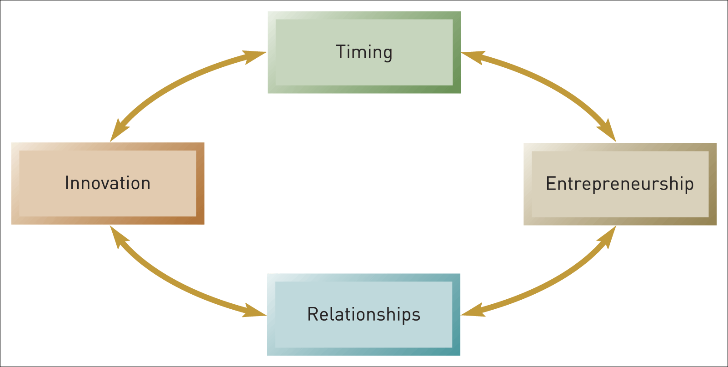
The innovation–entrepreneurship framework
Figure 9.1 The innovation–entrepreneurship framework

Slide 5

Innovation
Innovation involves the conversion of new knowledge into a new product, process or service and the putting of this new product, process or service into actual use.

Slide 6
Innovation dilemmas (1)
Technology push or market pull:
Technology push is the view that it is the new knowledge created by technologists or scientists that pushes the innovation process.
Market pull is the view that it is the pull of users in the market that is responsible for innovation. ‘Lead users’ are of particular importance.

Slide 7
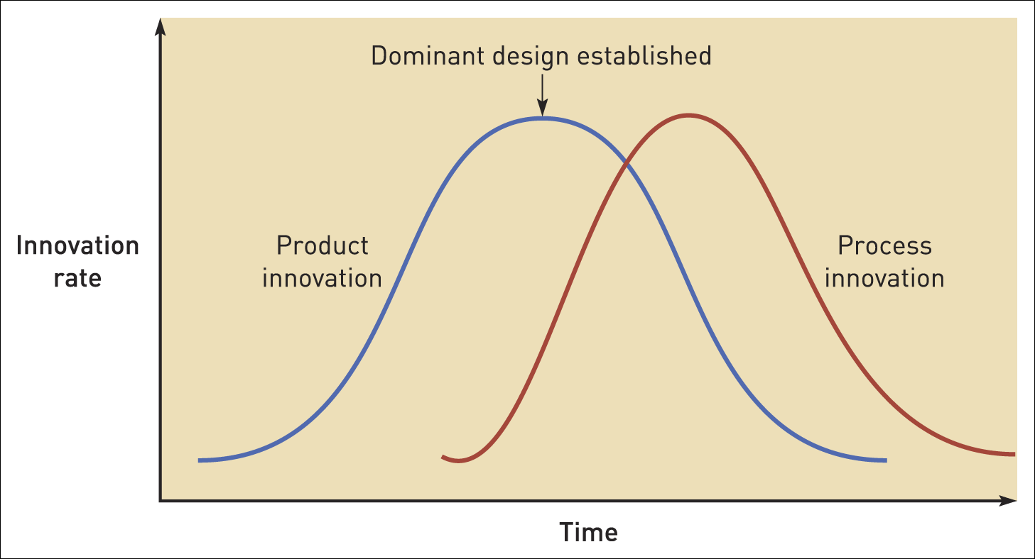
Product and process innovation
Figure 9.2 Product and process innovation
Source: Adapted from J. Abernathy and W. Utterback, ‘A dynamic model of process and product innovation’, Omega, vol. 3, no. 6 (1975), pp. 142–60

Slide 8
Implications of product/ process innovation model
New developing industries favour product innovation.
Maturing industries favour process innovation.
Small new entrants have greatest opportunities in early stages of an industry.
Large incumbent firms have advantage in later stages.

Slide 9
Innovation dilemmas (2)
Product or process innovation:
Product innovation relates to the final product (or service) to be sold, especially with regard to its features.
Process innovation relates to the way in which a product is produced and distributed, especially with regard to improvements in cost or reliability.

Slide 10
Innovation dilemmas (3)
Open or closed innovation:
‘Closed’ innovation – the traditional approach to innovation relying on the organisation’s own internal resources – its own laboratories and marketing departments. Innovation is secretive, anxious to protect intellectual property and avoid competitors free-riding on ideas.
‘Open’ innovation involves the deliberate import and export of knowledge by an organisation in order to accelerate and enhance its innovation. Exchanging ideas openly is seen as likely to produce better products more quickly.

Slide 11
Innovation dilemmas (4)
The balance between open and closed innovation depends on:
Competitive rivalry – if it is intense closed innovation is better.
‘One-shot’ or continuous innovation - open innovation is best where innovation is continuous.
Tight-linked innovation – closed innovation is best in order to avoid inconsistent elements.

Slide 12
Platform leadership
Platform leadership refers to how large firms consciously nurture independent companies through successive waves of innovation around their basic technological ‘platform’.

Slide 13
Innovation dilemmas (5)
Technological or business-model innovation:
A business model describes how an organisation manages incomes and costs through the structural arrangement of its activities.
Business model innovation involves re-organising all the elements of a business into new combinations. This can involve innovation in:
  The product. It may redefine what the product or service is and how it is produced.
  The selling. It may change the way in which the organisation generates its revenues – its selling and distribution activities.

Slide 14
Innovation diffusion
Diffusion is the process by which innovations spread amongst users. This can vary with respect to both speed and extent.

Slide 15
Supply side determinants of diffusion
Degree of improvement
Compatibility
Complexity
Experimentation
Relationship management

Slide 16
Demand side determinants of diffusion
Market awareness
Network effects
Customer innovativeness
Notes:
Use ebay video: start at 5:50 to 6:13. This is the section on how surprised ebay was that people are selling cars on ebay.

Slide 17
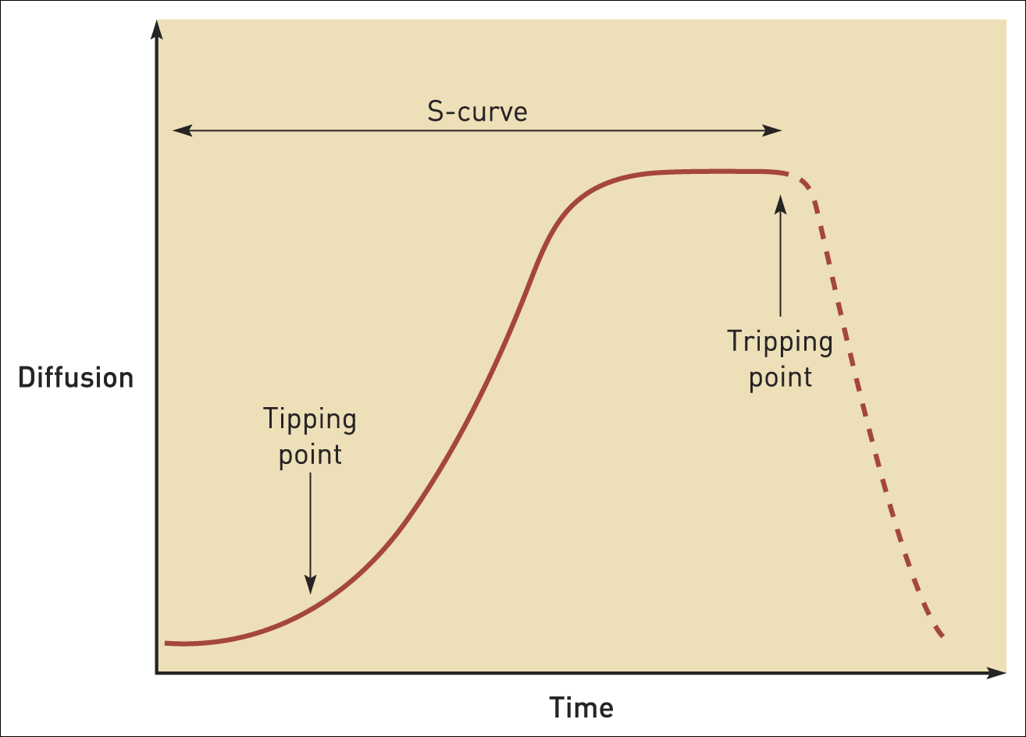
The diffusion S-curve
Figure 9.3 The diffusion S-curve

Slide 18
Decision points indicated by S-curve
Timing of the
tipping point
Timing of the
plateau
Extent of
diffusion
Timing of the
tripping point

Slide 19
Decision points indicated by S-curve
A tipping point is where demand for a product or service suddenly takes off, with explosive growth.
The tripping point is the opposite of the tipping point, when demand collapses – sometimes drastically but often more gradually.

Slide 20
What is a first-mover?
First-mover advantage exists where an organisation is better off than its competitors as a result of being first to market with a new product, process, or service. However there are also some disadvantages.

Slide 21
First-mover advantages
Experience curve
benefits
Scale
benefits
Pre-emption
of scarce
resources
Reputation
Buyer
switching costs

Slide 22
Late-mover advantages
Free-riding – imitating
pioneer’s strategies
but more cheaply
Learning – from the
mistakes made
by pioneers

Slide 23
First or second?
Three contextual factors in choosing between innovating and imitating:
  Capacity for profit capture
  Complementary assets
  Fast-moving arenas

Slide 24
What is a disruptive innovation?
Disruptive innovation creates substantial growth by offering a new performance trajectory that, even if initially inferior to the performance of existing technologies, has the potential to become markedly superior.

Slide 25
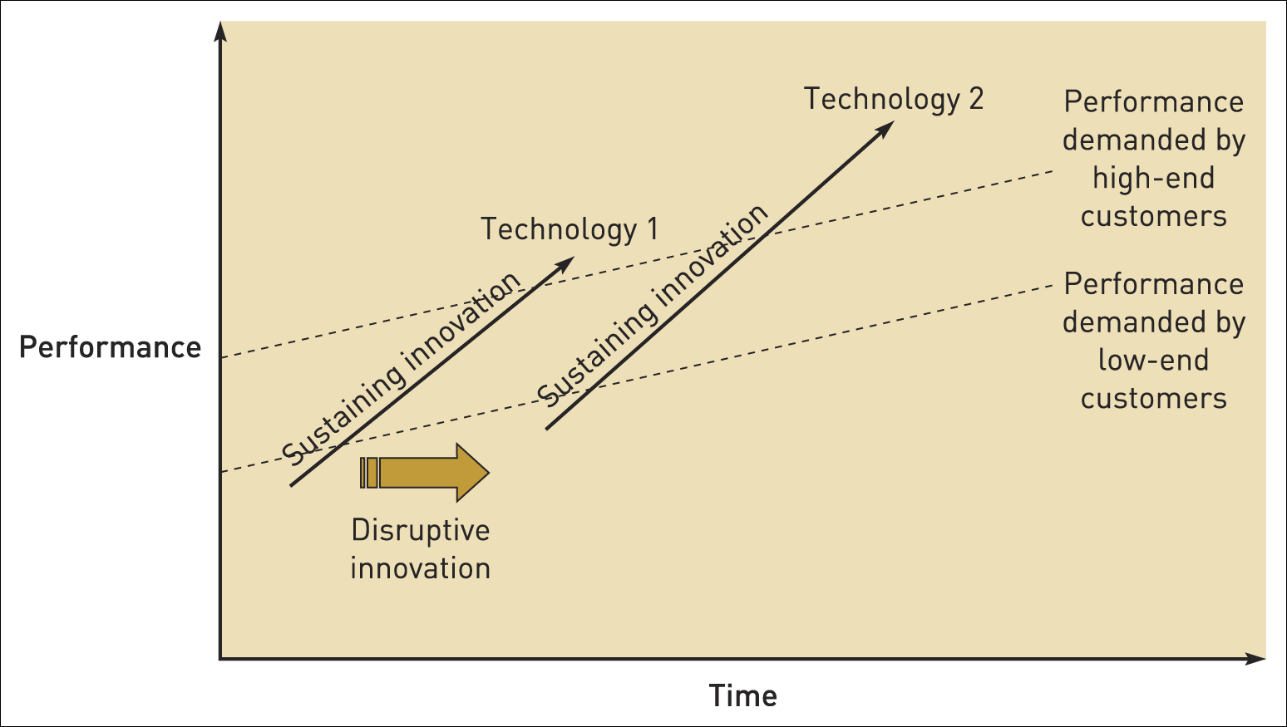
Disruptive innovation (1)
Figure 9.4 Disruptive innovation
Source: Reprinted by permission of Harvard Business School Press. From The Innovator’s Solution by C. Christensen and M.E. Raynor. Boston, MA 2003. Copyright © 2003 by the Harvard Business School Publishing Corporation. All rights reserved

Slide 26
Disruptive innovation (2)
Incumbents can follow two policies to help keep them responsive to potentially disruptive innovations:
  Develop a portfolio of real options (limited investments that keep opportunities open for the future);
  Develop new venture units – small, innovative businesses with relative autonomy.

Slide 27
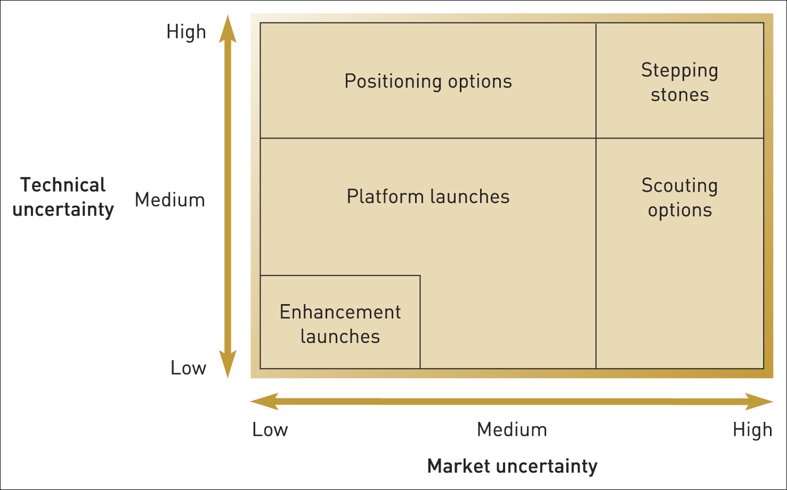
Portfolio of innovation options
Figure 9.5 Portfolio of innovation options
Source: Reprinted by permission of Harvard Business School Press. From The Entrepreneurial Mindset by I. MacMillan and R.G. McGrath. Boston, MA 2000, p. 176. Copyright © 2000 by the Harvard Business School Publishing Corporation. All rights reserved

Slide 28
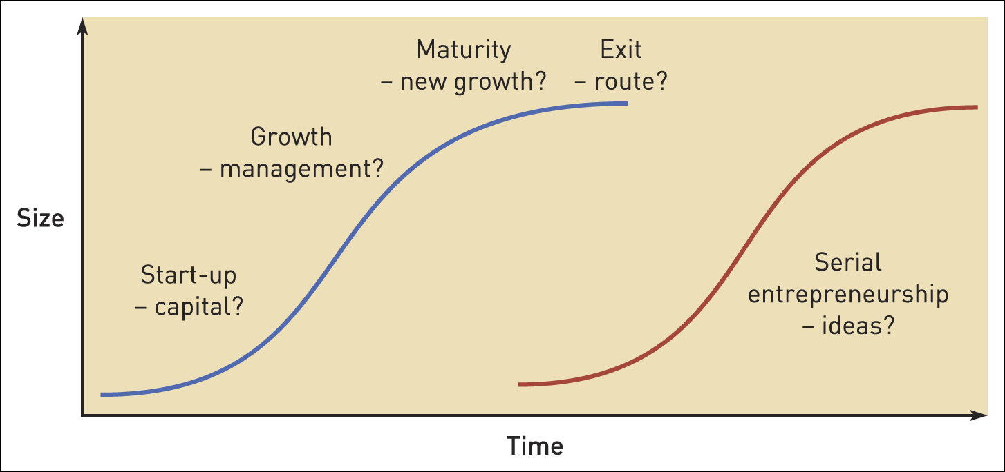
Stages of entrepreneurial growth
Figure 9.6 Stages of entrepreneurial growth and typical challenges

Slide 29
Entrepreneurial relationships
Entrepreneurship often involves managing relationships with other companies:
  Corporate venturing – investing externally in new ventures thereby protecting early-stage ventures from internal bureaucracy and by spreading risk.
  Spin-offs (or spin-outs) – the generation of small innovative units from larger organisations.
  Ecosystems – fostering communities of connected suppliers, agents, distributors, franchisees, technology entrepreneurs and makers of complementary products.

Slide 30
Social entrepreneurship
Social entrepreneurs are individuals and groups who create independent organisations to mobilise ideas and resources to address social problems, typically earning revenues but on a not-for-profit basis.

Slide 31
Social entrepreneurship decisions
Social mission
Organisational form
Business model

Slide 32
Summary (1)
Strategists face four fundamental dilemmas in innovation: the relative emphasis to put on technology push or market pull; whether to focus on product or process innovation; how much to rely on ‘open innovation’ and finally how far to concentrate on technological innovation as opposed to broader business-model innovation.
Innovations often diffuse into the marketplace according to an S-curve model in which slow start-up is followed by accelerating growth (the tipping point) and finally a flattening of demand. Managers should watch out for ‘tripping points’.
Managers must choose between being first into the marketplace and entering later. Innovators can capture first-mover advantages. However, ‘fast second’ strategies are often more attractive.

Slide 33
Summary (2)
Established incumbents’ businesses should beware disruptive innovations. Incumbents can stave off inertia by developing portfolios of real options and by organising autonomous new venture units.
Entrepreneurs face characteristic dilemmas as their businesses go through the entrepreneurial life cycle of start-up, growth, maturity and exit. Entrepreneurs have to choose how they relate to large firms as they may become involved in ecosystems or strategies for open innovation.
Social entrepreneurship offers a flexible way of addressing social problems, but raises issues about appropriate missions, organisational forms and business models.

